Slide 1
Modern Front-end Development with Angular JS 2.0
History of the front-end, Typescript, Component Architecture, Observables.

Slide 2
Javascript Frameworks
AnuglarJS, React, Backbone, TodoMVC, Ember, Polymer, Knockout, Aurelia, Spine, Brick, NuclearJS, Dojo, Matreshka

Slide 3
Javascript-Targeting Languages
Typescript, Dart, Coffeescript, asm.js, Coco, Uberscript, Caffeine, EmberScript, LiteScript, Flow, Latte JS

Slide 4
Why?

Slide 5
Times Have Changed
(The Web is Maturing)

Slide 6
1. Hyper-text (1963)
2. HTML on WWW (1987)
3. AJAX (1999)
4. Html5 “App SandBox APIs” (2004)
5. Web Assembly, Components (Now)
6. ???

Slide 7
The Browser Is Just A Client

Slide 8
Desktop application
Smartphone app
Web app
Embedded device (IoT)
It’s just another client.

Slide 9
Web App or Native App?
Communicates over HTTPS
Runs in fullscreen
Store data locally between runs
Works offline
Renders OpenGL graphics
Uses background threads
Can geo-locate using GPS
Supports gamepads/joysticks
Uses system speech recognition

Slide 10
The Browser Isn’t a Perfect Platform, but Angular JS Can Help

Slide 11
But First …

Slide 12
TypeScript
Superset of Javascript (ES6) with optional typing
Open source (Windows, Linux, OS X nee macOS)
Passes code through — very little mangling
Weakly-typed vs. strongly-typed (use both!)
Recommended but not required for AngularJS 2.0

Slide 13
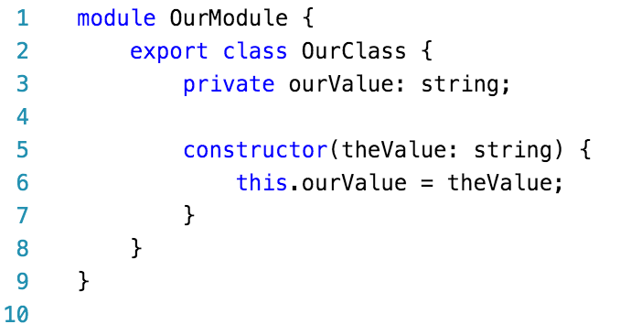
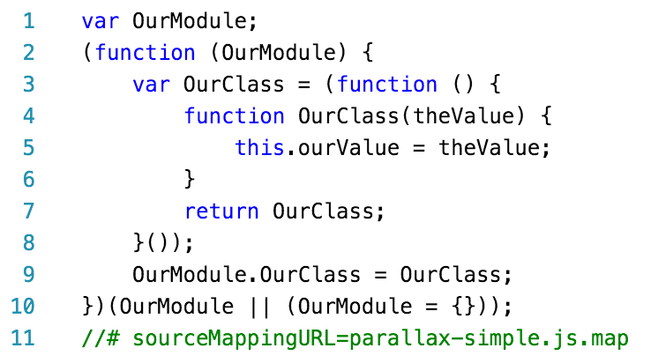
TypeScript Compiler (TSC) Output
Typescript
Outputted Javascript
tsc --sourcemap --target ES5 parallax-simple.ts

Slide 14
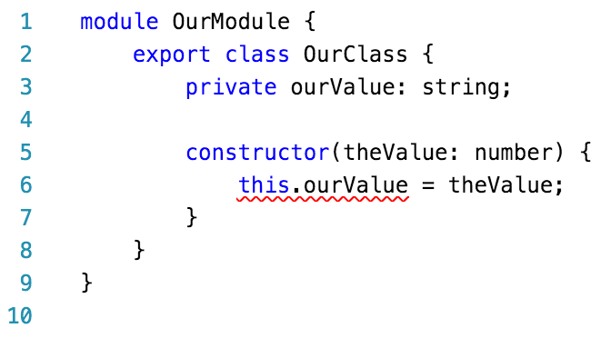
TypeScript Compiler (TSC) Output
parallax-simple.ts(6,13): error TS2322: Type 'number' is not assignable to type 'string'.
Type-checking done at compile time but errors allowed (Javascript allows it)
Reduces errors while developing
Helps editors provide assistance (VS Code, WebStorm, others)

Slide 15
Angular JS 2.0

Slide 16
Angular JS 2.0
Open source, developed by Google + community
Application framework for web and native applications
Encourages code reuse through modules
Not backwards-compatible with AngularJS 1.x but there is a migration path
Typescript preferred
Much faster than Angular JS 1.x
Cleaner architecture than Angular JS 1.x

Slide 17
Angular JS 2.0 Architecture
Component-based design.
Everything is a “directive” in one of three types: component (class with a view template), structural (alters DOM e.g. ngIf, ngSwitch, ngFor), or attributive (affects style or behavior, e.g. ngClass).
Uses dependency injection.
Services are any Javascript class you register for injection. Preferably contain discrete, unique groupings of application logic.
Miscellany: pipes, lifecycle hooks, routers, animation, and more.

Slide 18
Angular JS 2.0 Architecture
Credit: https://angular.io/resources/images/devguide/architecture/overview2.png

Slide 19
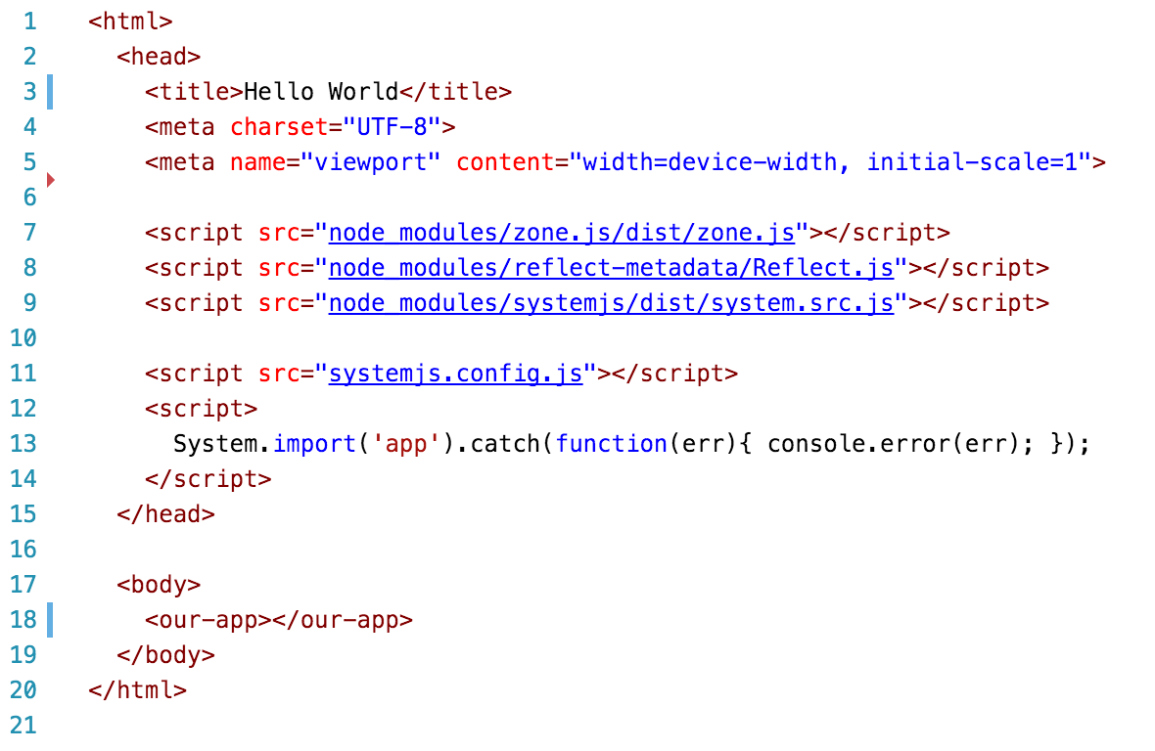
Angular JS 2.0 Hello World
From https://angular.io/docs/ts/latest/quickstart.html

Slide 20
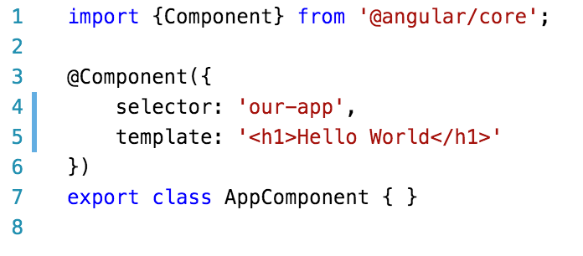
Angular JS 2.0 Hello World
From https://angular.io/docs/ts/latest/quickstart.html

Slide 21
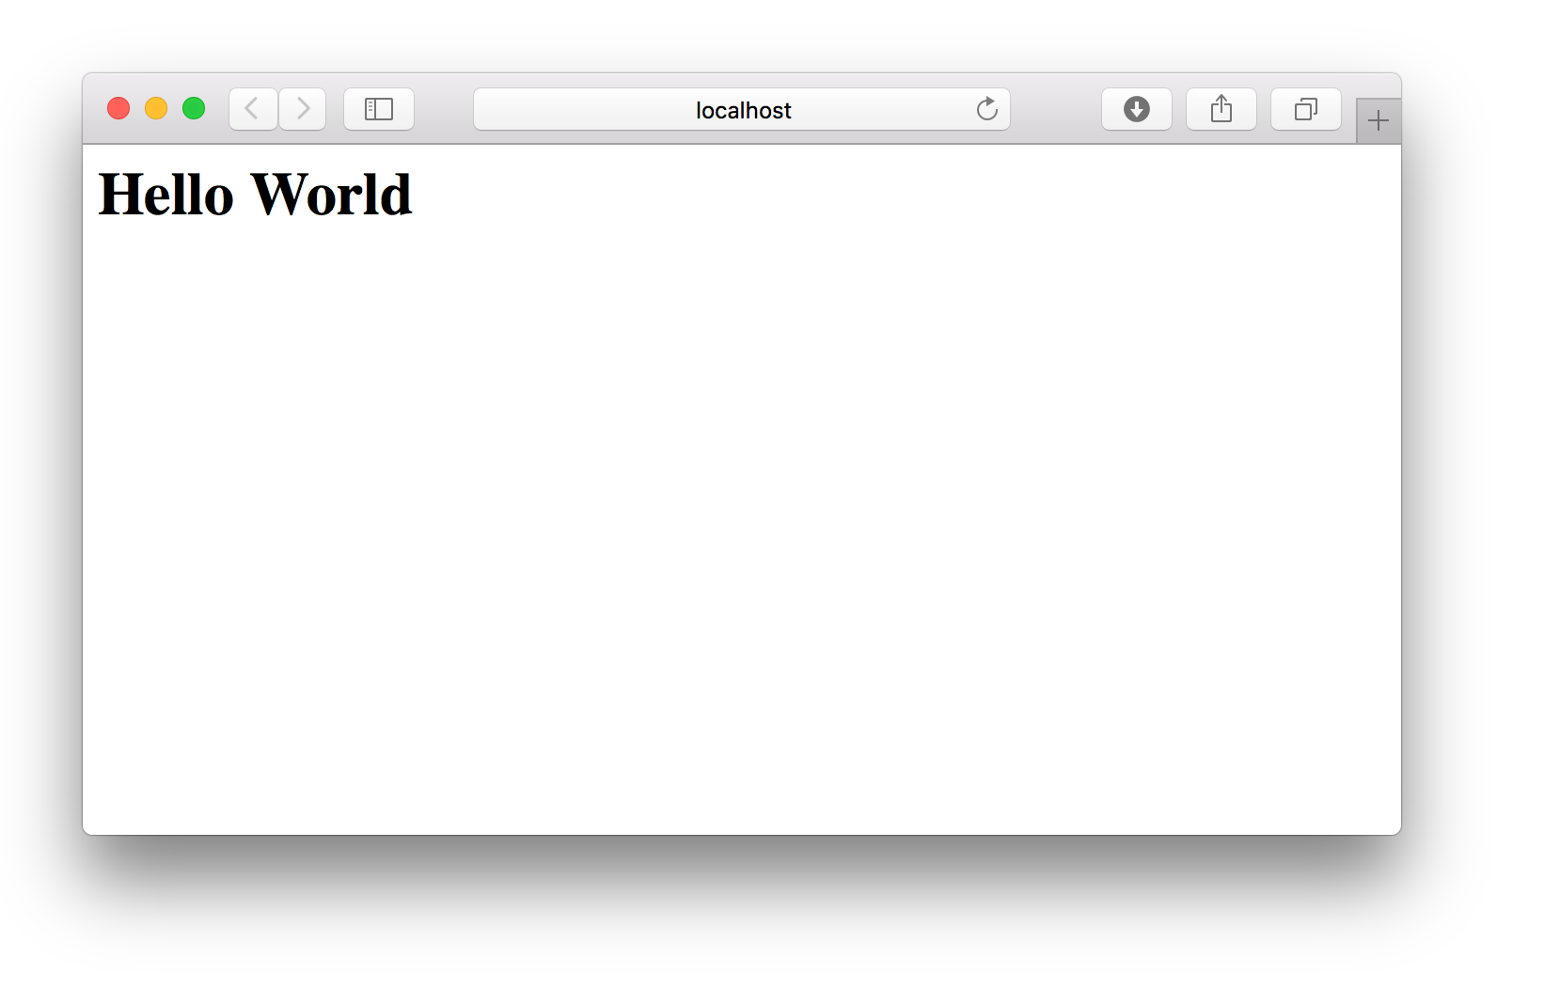
Angular JS 2.0 Hello World

Slide 22
WOW!

Slide 23
Data Binding Via Interpolation

Slide 24
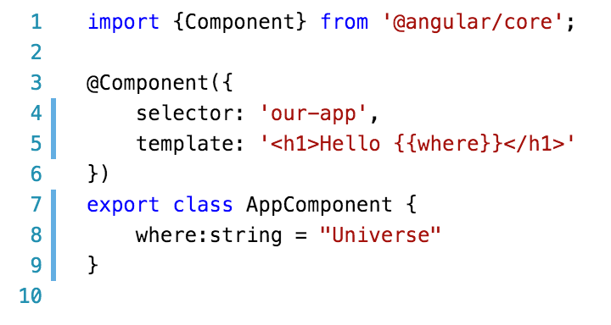
Angular JS 2.0 Hello World

Slide 25
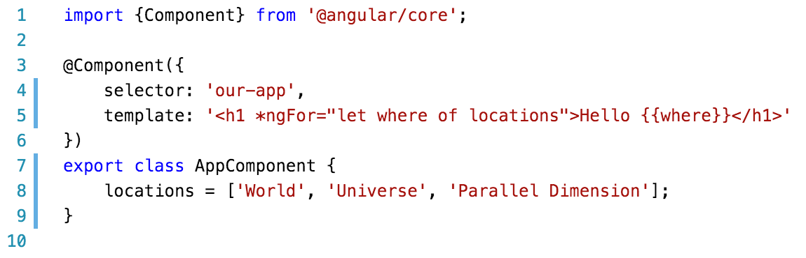
Angular JS 2.0 Hello World

Slide 26
Basic Event Handling

Slide 27
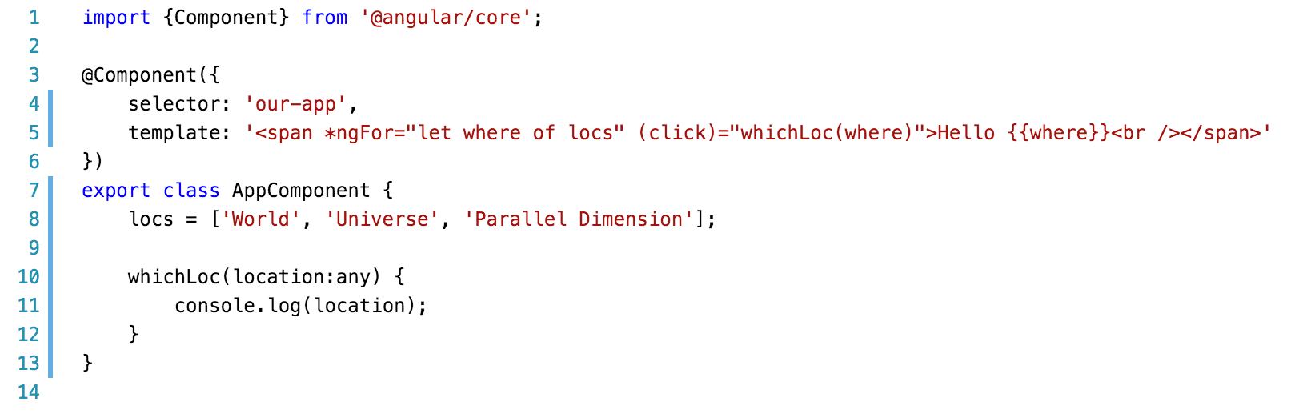
Angular JS 2.0 Hello World

Slide 28
Components In Components

Slide 29
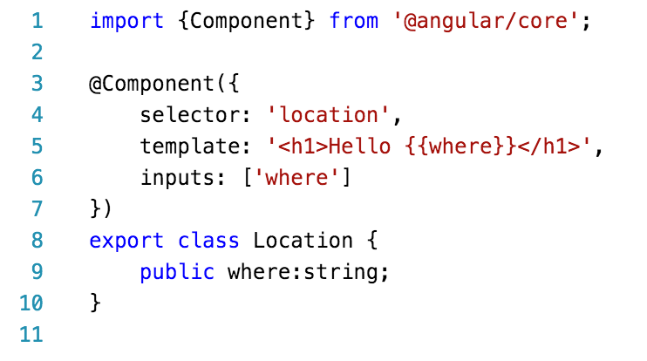
Angular JS 2.0 Hello World

Slide 30
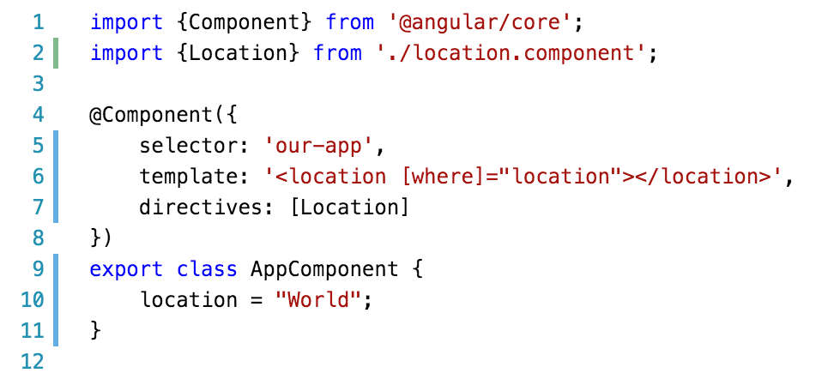
Angular JS 2.0 Hello World

Slide 31
Javascript Patterns
Javascript at Netscape (1995)
Callback culture with jQuery (2006)
Promises (2010)
Observables (2012)

Slide 32
Observables Are Cool

Slide 33
Observables Are lazy Promises Which can be cancelled and re-tried

Slide 34
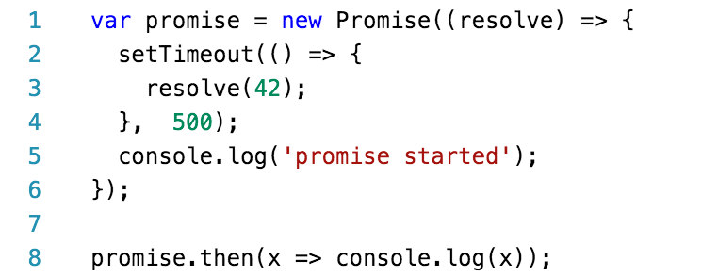
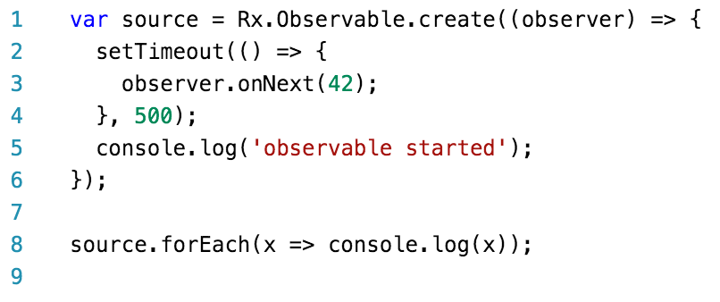
Promise Vs Observable
Promise
Observable
From https://egghead.io/lessons/rxjs-rxjs-observables-vs-promises

Slide 35
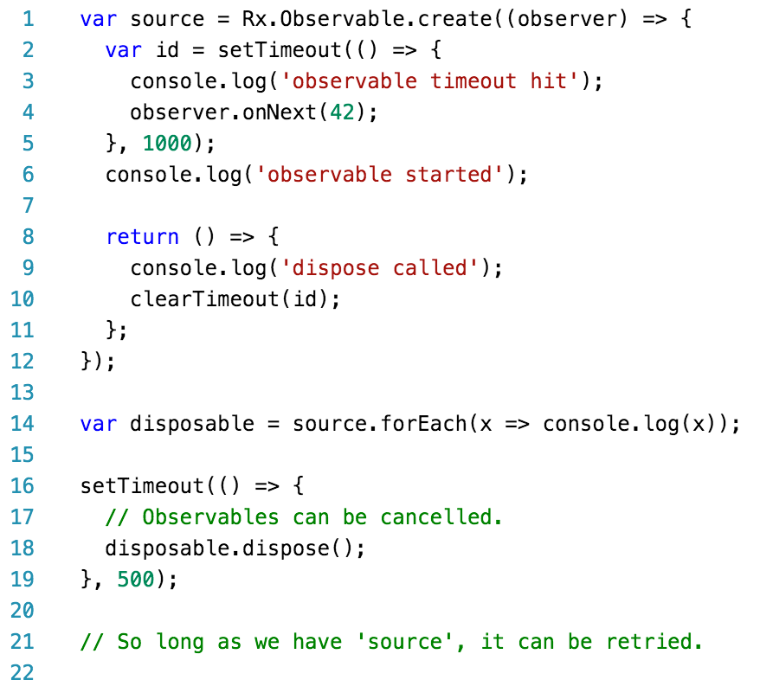
Promise Vs Observable
From https://egghead.io/lessons/rxjs-rxjs-observables-vs-promises

Slide 36
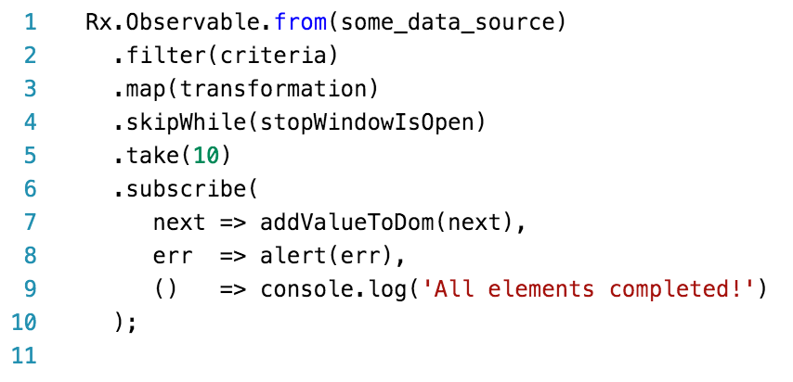
Promise Vs Observable
Officially included in ES7
From https://www.quora.com/What-is-the-most-useful-thing-you-can-do-with-RxJS-observables

Slide 37
Resources
https://angular.io
http://typescriptlang.org
https://code.visualstudio.com
https://egghead.io

